Slide 1
Blackwell Electronics Understanding Customer Preferences
TEAM lsu - Jason Rodriguez, Axita gupta, Andres Saucedo
02/05/2020

Slide 2

Project Objectives
Customer Understanding
Product Brand Preference and Recommendations
Acquisition Determination – Market Basket Analysis
Path Forward
Understand our customer needs and their preferred brand that can help Blackwell Electronics to build targeted market strategies.
Assist the Sales department with identifying the most profitable product mix.
Discover association between frequently bought items and leverage this information for collaborative marketing strategies.
Identify strategies and recommendation to leverage data mining techniques and position Blackwell Electronic to compete in the e-Commerce arena.

Slide 3





3 Key Goals
Understanding Our Customers – broaden our insights into our customer base in order to drive strategic marketing initiatives that are very targeted.
Product Predictions
Product Predictions– understanding specific product types to assist the Sales team with product placement and volume forecast.
Data
Mining
Acquisition Product Analysis– conducted a Market Basket Analysis to understand potential product associations of potential acquired company.
Customer Understanding
Acquisition Product Analysis

Slide 4
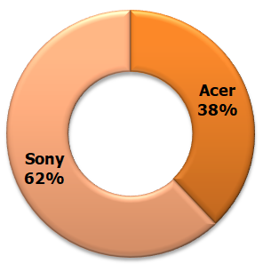
Goal 1- Understanding Our Customers
Product Predictions
Data
Mining
Customer Brand Preference
Customer Understanding
Market Basket Analysis
Main Purpose - to find out which brand of computers customers prefer
Help Blackwell electronics in deciding which manufacturer they should pursue a deeper strategic relationship.
Total 14898 customer transaction data analyzed
62% customers prefer SONY
38% customers prefer ACER
Recommendation : Since Sony is the most preferred brand among customers Blackwell Electronics should consider having deeper strategic relationship with Sony

Slide 5
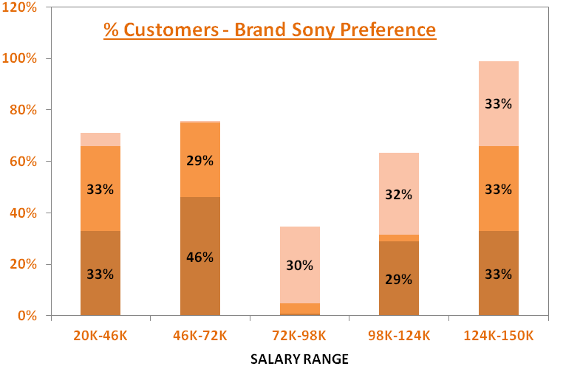
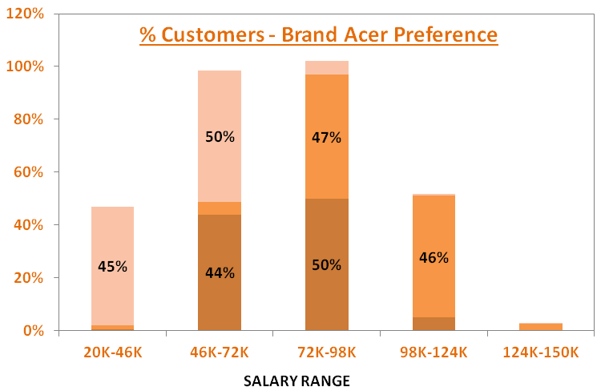
Goal 1- Understanding Our Customers
Product Predictions
Data
Mining
SONY
Customer Understanding
Market Basket Analysis
ACER
Age segments:
20 – 40 Years Old
40 – 60 Years Old
60 – 80 Years Old
Salary segments:
20K – 46K → Low salary
46K – 72K → Low – Mid salary
72K – 98K → Mid salary
98K – 124K → Mid – High salary
124K – 150K → High salary
Age Range
20 - 40 | All salary ranges except Mid level salary range
40 - 60 | All salary ranges except Mid level salary range
60 - 80 | Mid and Mid-High level salary range
Age Range
20 - 40 | Low and Mid level salary range
40 - 60 | Mid and Mid-High level salary range
60 - 80 | Low and Low-Mid level salary range

Slide 6
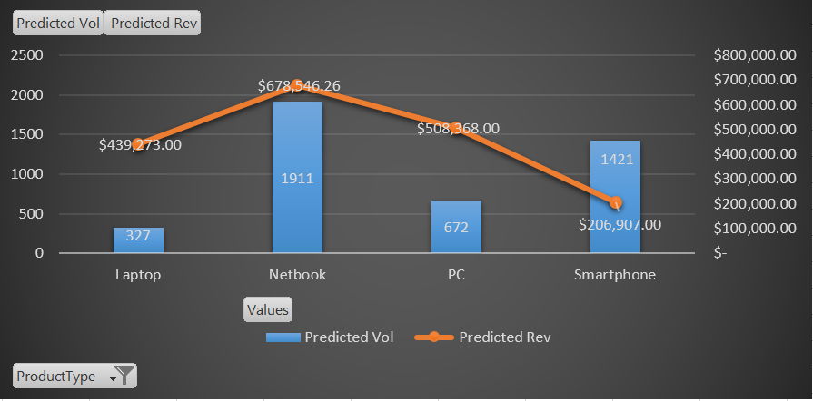
Goal 2 – Products Forecasting
Product Predictions
Data
Mining
Customer Understanding
Market Basket Analysis
Objective: Establish a Predictive Model to aid in the forecast of 4 key product types at Blackwell Electronics – Laptops, Netbooks, PC, & Smartphones
Recommendations:
Seek opportunities to market Laptops & PCs to targeted customer demographics given the high revenue and profit margins associated with those products. Low Volume but High Returns
Continue to focus on marketing Netbook products but seek opportunities to cross-sell other products to increase sales via other products.
Notes:
Used a Random Forest model

Slide 7
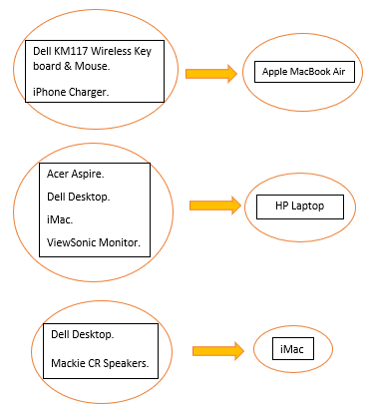
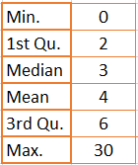
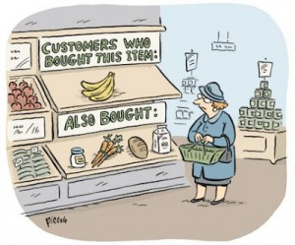
Goal 3 – Market Basket Analysis
Product Predictions
Data
Mining
Associations
Customer Understanding
Market Basket Analysis
Electronidex: B2B
Market Basket
Notes:
We can see on the graph to the left the number of transactions on the x-axis and the frequency on the Y axis. Interpreting this graph, A transaction that occurred alone, occurred 2163 times, 2 transactions occurred 1647 times, 3 transactions occurred 1294 times, etc. Additionally, it is abundantly clear that many items and accessories were bundled and purchased together, so we can conclude that the primary type of business that Electronidex is Business to Business
On the right, If the condition is fulfilled, then the result is produced. OR If Items in the item set are purchased, then Item on the right-hand side is likely to be purchased too. So we are 81% confident that if Acer Inspire, Dell Desktop and ViewSonic Monitor were purchased together, an HP laptop likely will be purchased as well.

Slide 8
Goal 3 – Market Basket Analysis
Product Predictions
Data
Mining
Customer Understanding
Market Basket Analysis
Notes:
- To the left is Blackwells volume by product type sorted from highest to lowest. On the Right, is Electrnidex’s top 10 most frequently purchased items.
As you can see, to the left, the lowest performing product types are arguably the highest performing transactions at Electronidex.
the lowest performing product types for Blackwell are arguably the highest performing transactions at Electronidex.
Acquiring Electronidex would be risky because Electronidex is primary a Business to Business operation. Although, Blackwell is only a Business to Consumer operation, an acquisition of such a company will boost sales of the less popular products Blackwell is selling and increase revenues and profits by a bug margin.

Slide 9
Summary & Recommendations
Which Brand of Products Customers Prefer
Sony is the overall preferred brand by customers
However, ACER is preferred brand for certain age and salary groups as previously indicated.
Blackwell Electronics should consider marketing strategies for these age/salary groups to promote and increase sales of ACER computers.
Impact services reviews and customer reviews
Both type of reviews greatly affected overall sales. Sales should consider these reviews in their strategy.
Electronidex Acquisition
Electronidex is a B2B while Blackwell is B2C → both have different clientele → acquisition can be challenging and risky
The lowest performing product types for Blackwell are the highest performing transactions at Electronidex.
Blackwell Electronics should consider deeper and strategic data mining techniques like understanding customer preferences and market basket analysis for the increased product inventory, if they acquire Electronidex.

Slide 10




Data Mining, Can….
PREDICT CUSTOMER CHURN
Predict how many clients discontinued a service, an application or stopped buying a product during a certain period of time.
FRAUD ANALYSIS
Detect fraud and take immediate action to minimize costs.
Through the use of data mining tools, millions of transactions can be searched to spot patterns and detect fraudulent transactions.
PREDICT TRENDS
Predict the next top selling items by various categories to be at the forefront of the market.
PREDICT MARKET BASKET
Identify combination of products typically purchased together and drive increase in sales
PERSONALIZE OUR CUSTOMERS
Create dynamic websites that are filled with relevant products based on historic behavior and behavior of similiar demographics.
Generate product recommendations for online behavior
OPTIMIZE PRICING
Identify the best price by tracking transactions, competitors, cost of goods and other variables.
1% price increase translate to 8.7% increase in operating profits
Notes:
Market Basket Analysis:
Process of looking for combinations of items that are often purchased together in one transaction.
DATA MINING: use to find patterns and relationship in the data.
GET PERSONAL
With big data and data mining, technologies exist to empower retail businesses to generate dynamic websites that are filled with relevant products based on the historic behavior and behavior of similar customers.
Automated recommendations have a huge impact on sales conversion. Percentage of order influenced by a personalized recommendation…
29% Non-Clothing Retail
35% Clothing Retails
43% Multi-Category Retail
Amazon has mastered this approach.
OPIMIZED PRICING
1% price increase translates into 8.7% increase operating profits
30% of pricing decisions businesses make every year fail to deliver the best price.
With data mining and data analytics, retailers can map the rise and fall of demand and match pricing accordingly. Action can be taken on insights in a matter of minutes.
PREDICT TRENDS
Comb through social media and web browsing habits to identify what creating a buzz in the market place.
Understand ad-buying data to see what marketing departments are currently pushing
Sentiment analysis determines the context in which a product is discussed online. Are the conversations positive or negative.

